Slide 1
Student portfolio
STUDENT NAME : Nandhini J
REGISTER NO : 24131210500122026 AND
NAANMUDHALVAN ID : asanm121anm12124213026
DEPARTMENT : BCA
COLLEGE : Immaculate college for women/Annamalai University

Slide 2
Project title
Student portfolio developed with
HTML,CSS and JavaScript

Slide 3
Agenda
Problem statement
Project overview
End users
Tools and technologies
Portfolio design and layout
Features and functionality
Results and screenshot
Conclusion
GitHub link

Slide 4
Problem statement
I want to create a portfolio That effectively Showcase my skill and experience to potential employer or clients, but I am not sure how to present my work in a clear.
The lack of centralized easily accessible, and visually appealing platform makes it difficult for individuals to present their work effectively. This create challenges in personal branding, networking and career growth.

Slide 5
Project overview
The goal of this project is to create a responsive and visually appealing portfolio show my skill.
This project is a single page student portfolio website developed using HTML, CSS and JavaScript.
Increase online visibility and credibility.

Slide 6
End users
Student ~ to evaluate a skill, creativity, learning and project.
Clients ~ to see your past work before giving projects.
Recruiters ~ to evaluate skill, improving experience and suitability for a job.
Faculty ~ to assess student progress and provide academic reference.

Slide 7
Tools and technologies
HTML – Structure of the portfolio (heading, sections, text and image).
CSS – Styling, layout and responsiveness.
JavaScript – Interactivity and animation, dynamic features.
GitHub – version control and project hosting.

Slide 8
Portfolio design and layout
Consistent – consistency in layout, typography and Colour scheme helps to create a professional look.
Grid based – use a grid system to organize your content and create a balance layout.
Colour scheme – select a colour scheme that is consistent with complement your work.
Image – use high quality images that showcase your work effectively.

Slide 9
feature and functionality
Responsive design using css and html.
Interactive navigation bar with smooth scrolling.
Dedicated section for skill , project and contact information.
JavaScript enable animation and interactive elements.
Website adapts to different screen size and device.
Social media integration.

Slide 10
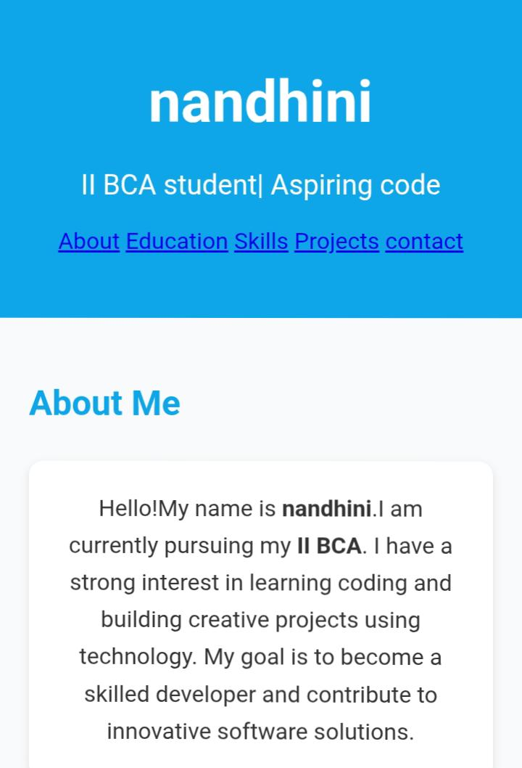
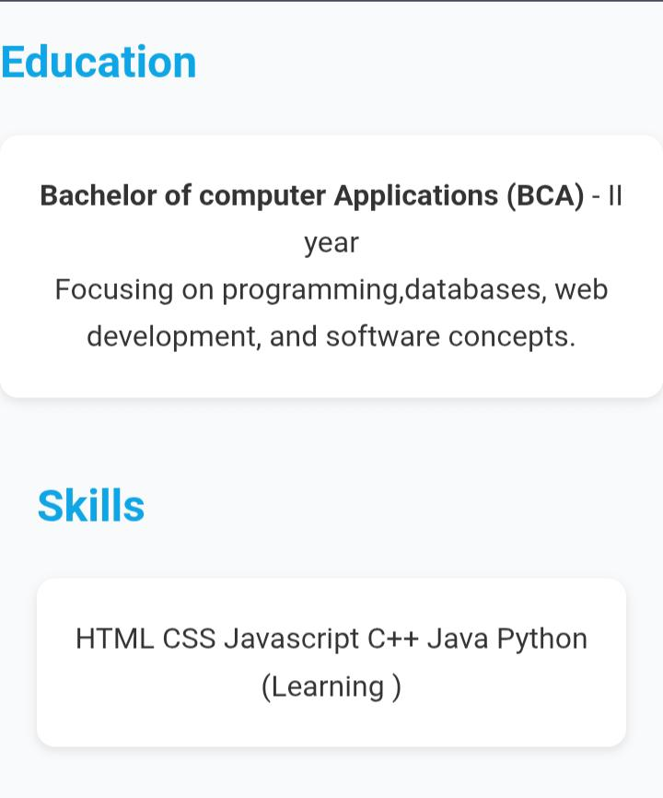
Results and screenshot

Slide 11
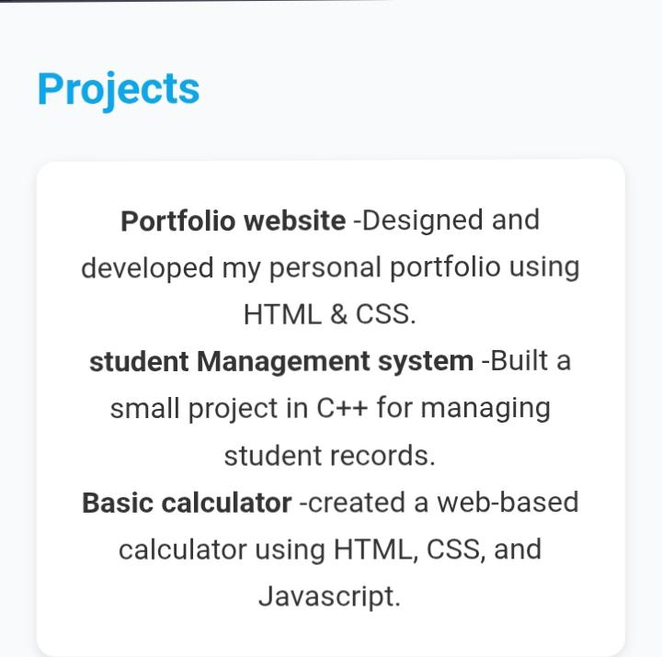
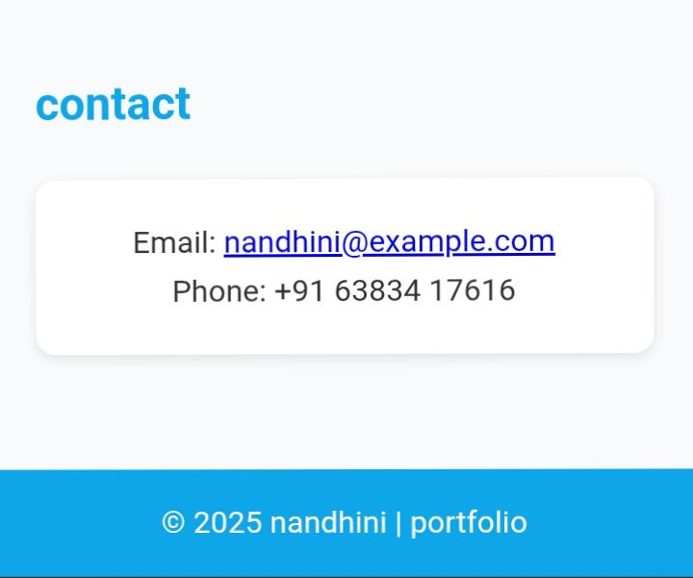
Results and screenshot

Slide 12
Conclusion
The portfolio becomes not just a static webpage but an engaging, responsive and professional platform to highlight talents. It also demonstrates front-end developer skills, which are essential for academic, professional or freelancing opportunities.
In short, a portfolio built with these technologies reflects creativity, technical ability and attention to detail all of which leave a strong impression on potential employer and clients.

Slide 13
GitHub
https://github.com/

